Slide 1

BASIC ELECTRICAL AND ELECTRONICS ENGINEERING
Course Code: CSE1002
SCHOOL OF COMPUTER SCIENCE ENGINEERING AND APPLICATIONS
Mrunmayee Rahate
Assistant Professor, DYPIU

Slide 2
Module 2: Semiconductor Devices and Applications
Lecture 3: Rectifiers: Half-wave, Full-wave (Center-Tap and Bridge)

Slide 3
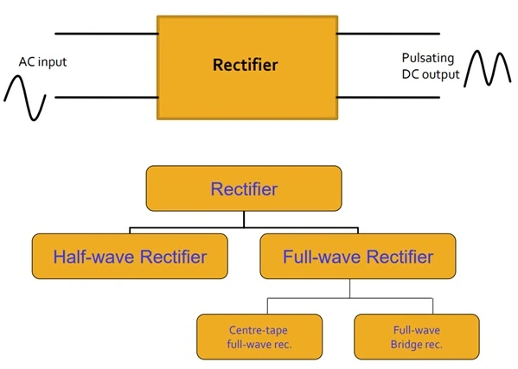
Diode as a Rectifier
A rectifier is an electronic device that converts alternating current (AC) into pulsating direct current (DC) by allowing current to flow in only one direction

Slide 4
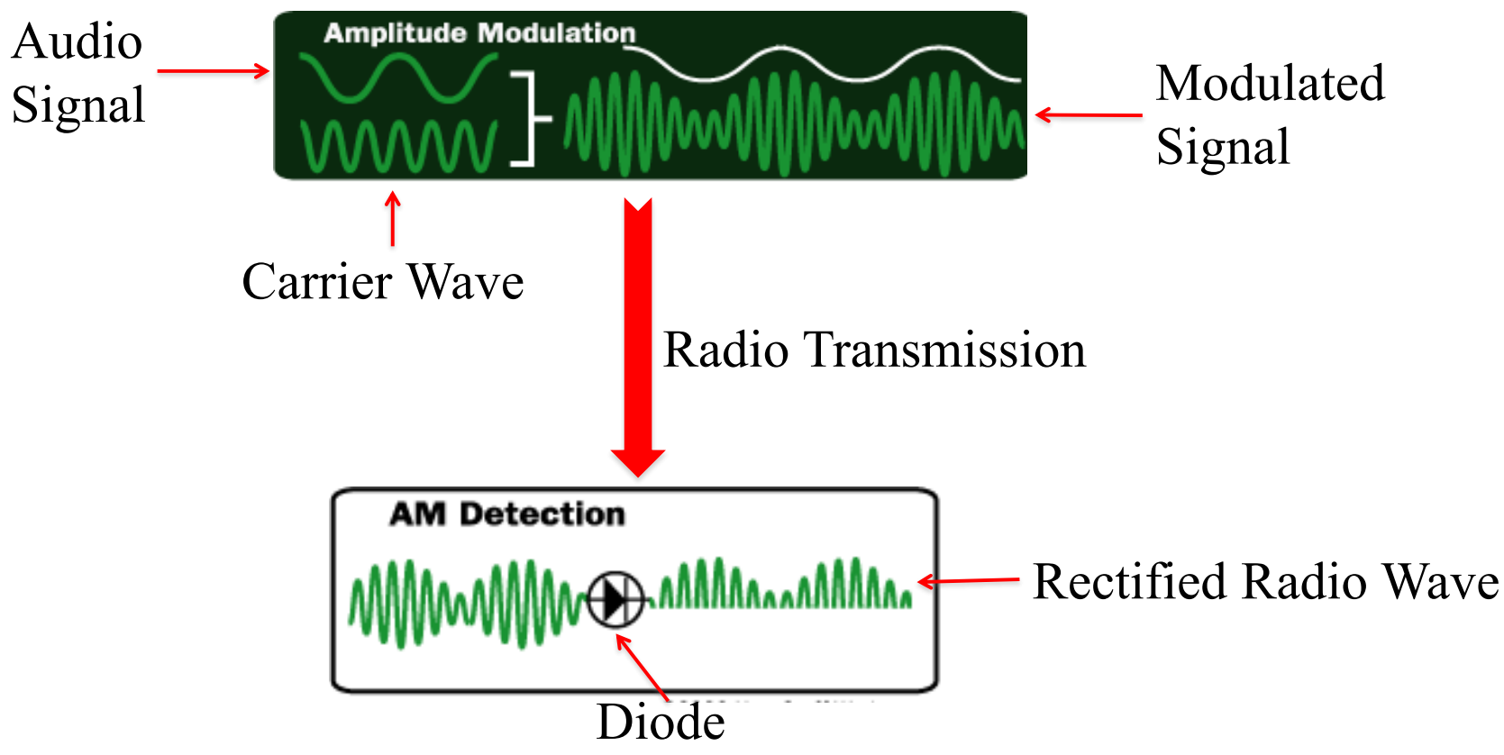
Rectification application

Slide 5
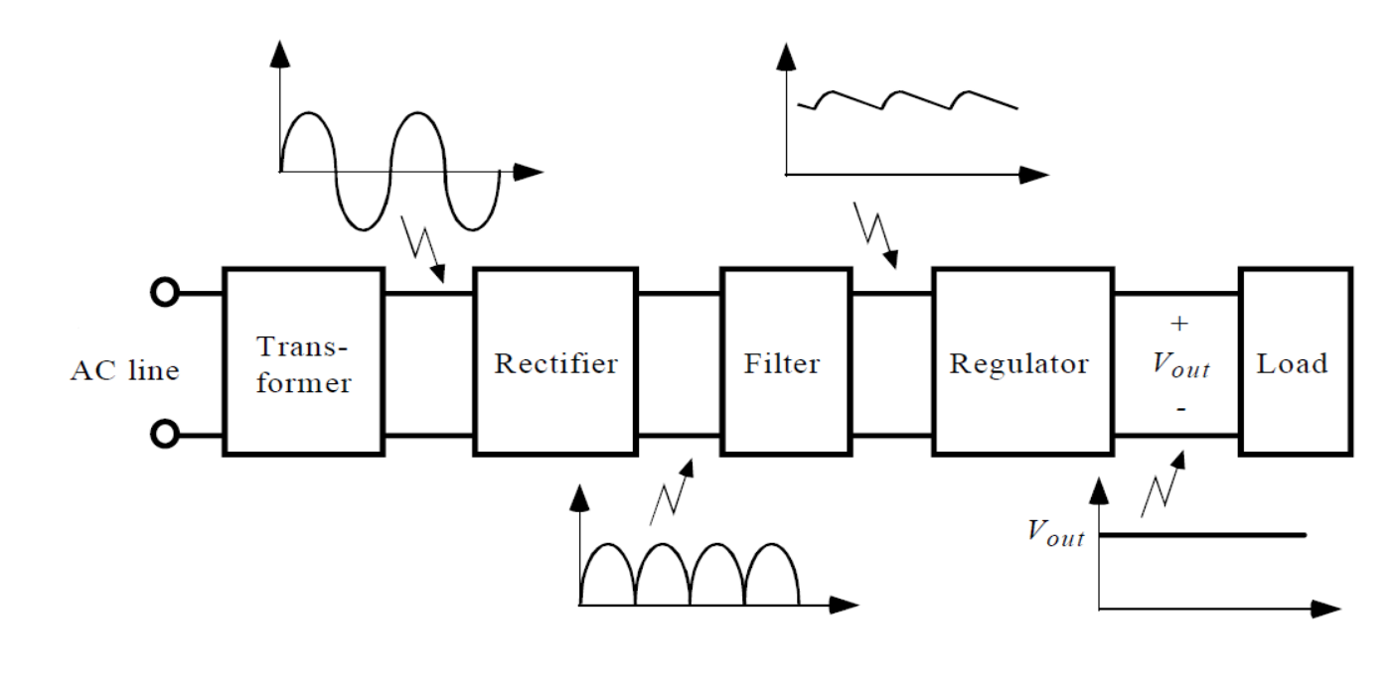
Regulated power supply

Slide 6
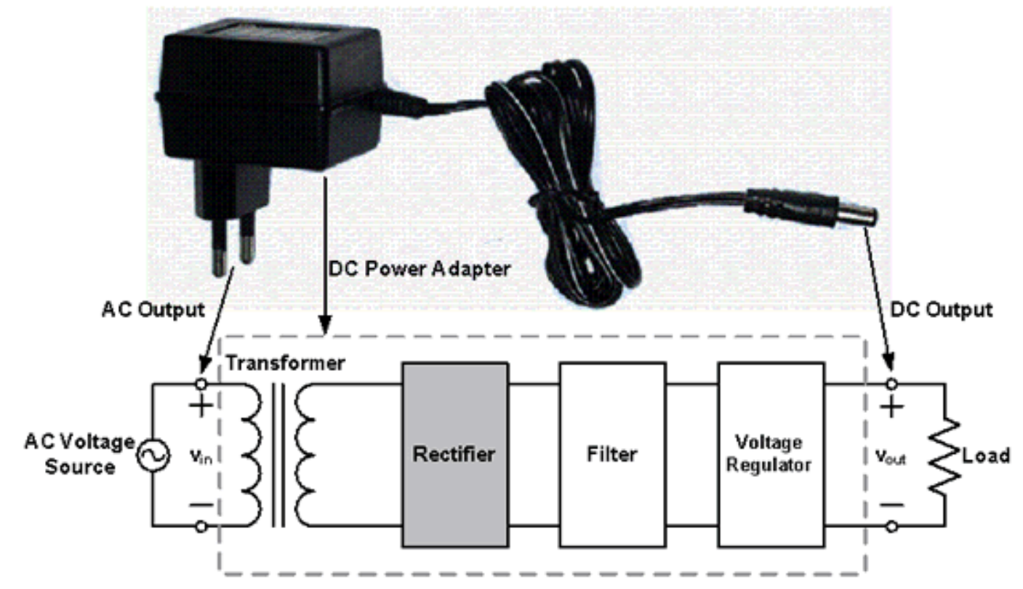
Regulated power supply

Slide 7
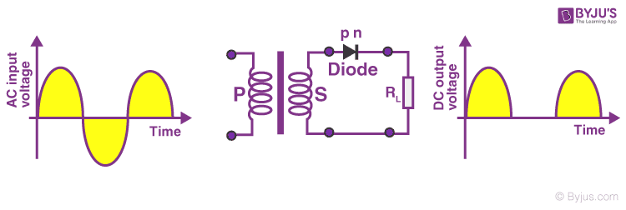
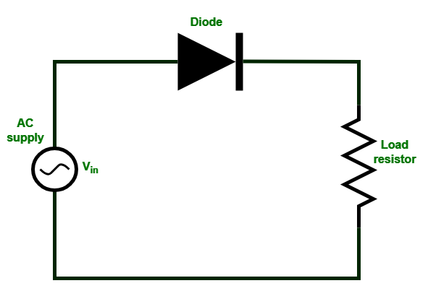
Half wave Rectifier
A half-wave rectifier works by using a single diode to convert AC to pulsating DC by allowing only the positive half-cycle of the AC waveform to pass through and blocking the negative half-cycle
Circuit
Waveforms

Slide 8
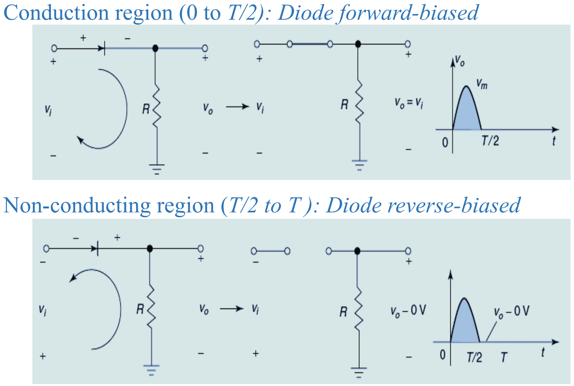
Half wave Rectifier - working
Positive half-cycle of the input: When the input voltage is positive, the diode is forward biased and act as a short circuit. This allows current to flow through the circuit and through the load resistor. The output voltage at this time is a positive half-sine wave.
Negative half-cycle of the input: When the input voltage is negative, the diode is reverse biased and act as an open circuit. Consequently, there is no current and no output voltage during this half-cycle.

Slide 9
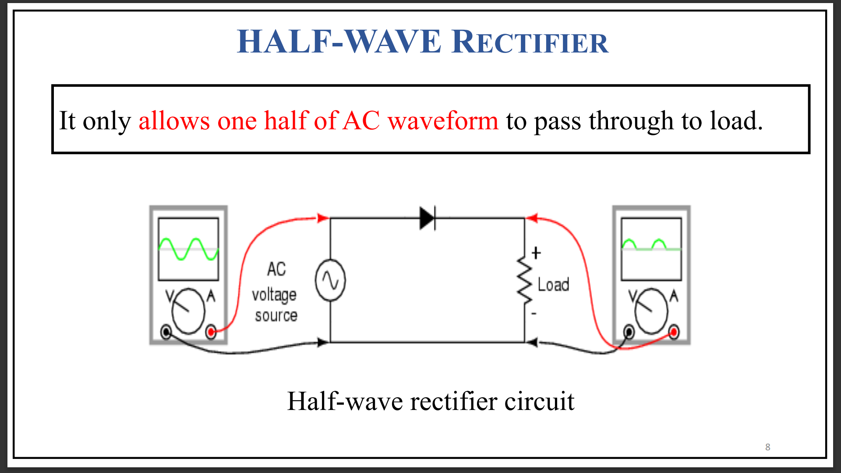
Half wave Rectifier

Slide 10
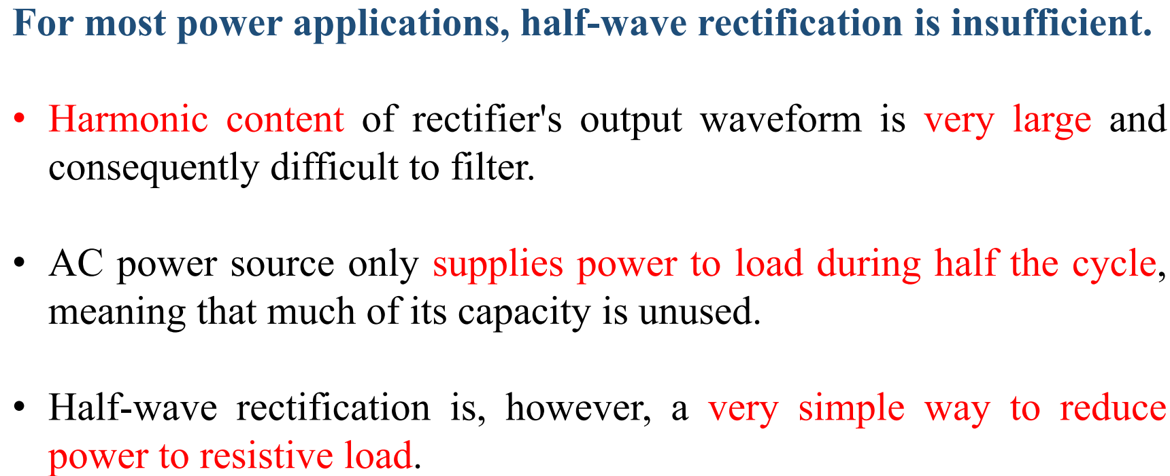
Half wave Rectifier – Advantage and drawback

Slide 11
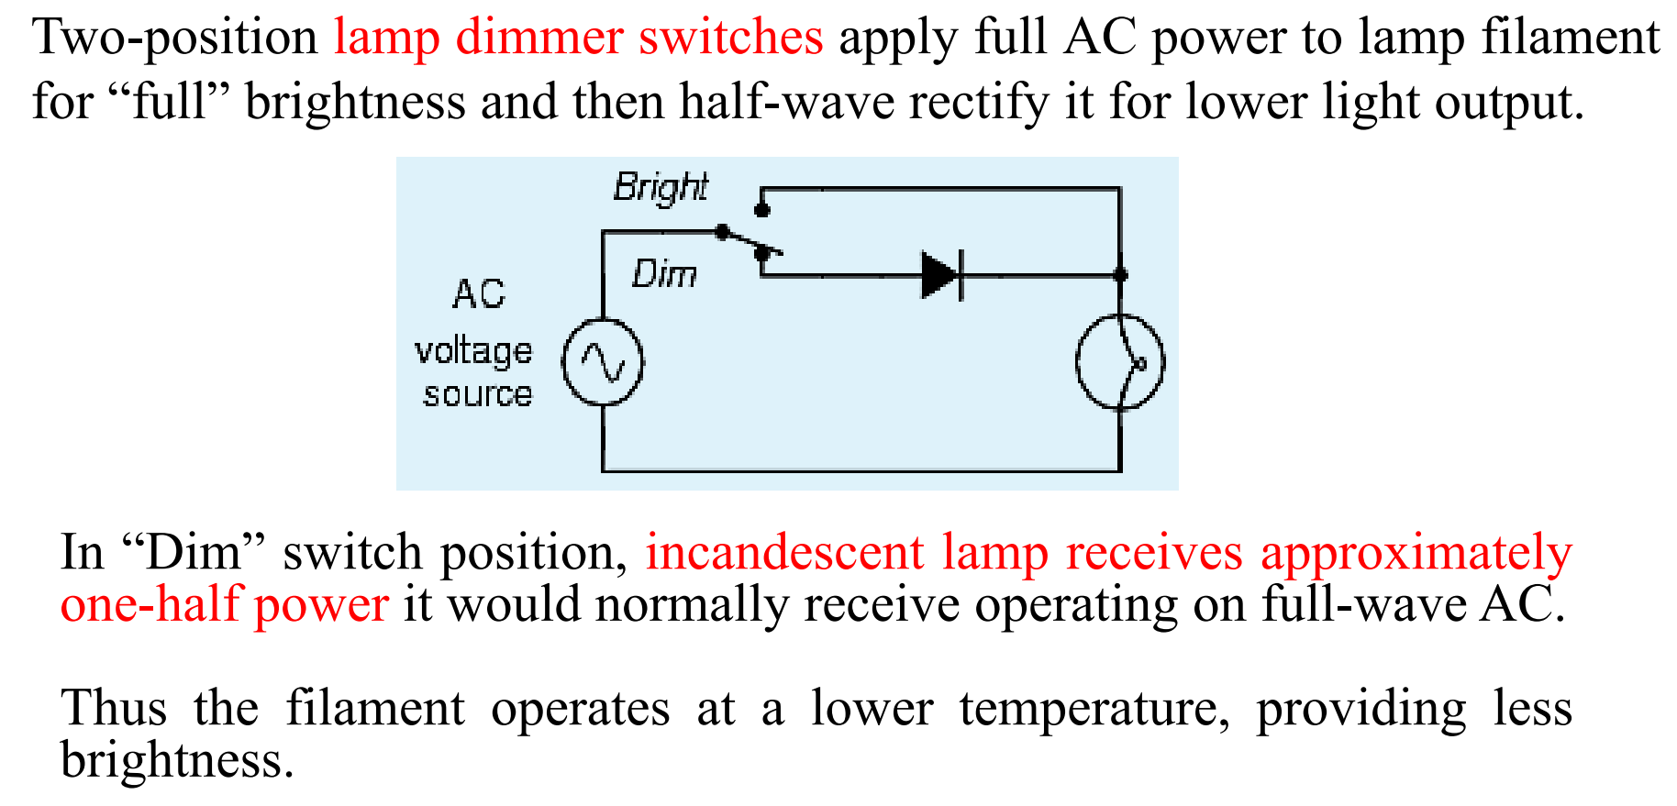
Half wave Rectifier - Application

Slide 12
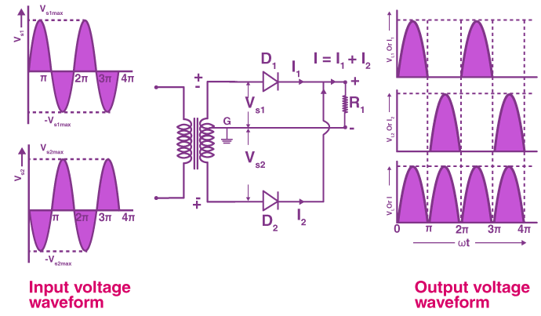
FULL wave Rectifier (Centre - tap)
A full-wave rectifier is an electronic circuit that converts both the positive and negative half-cycles of an alternating current (AC) into a pulsating direct current (DC).

Slide 13
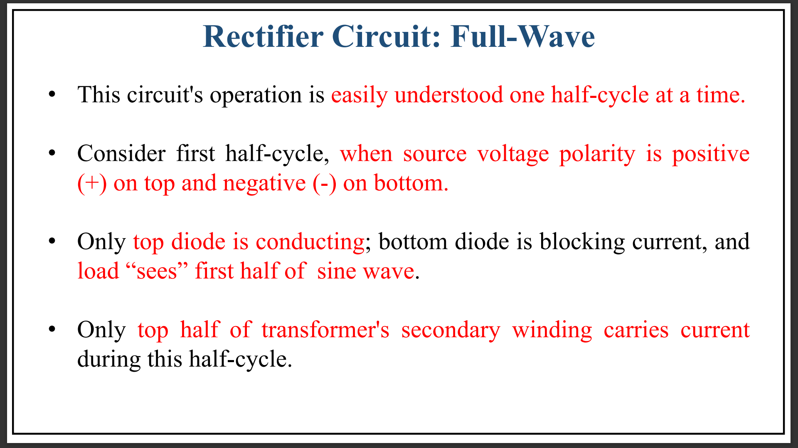
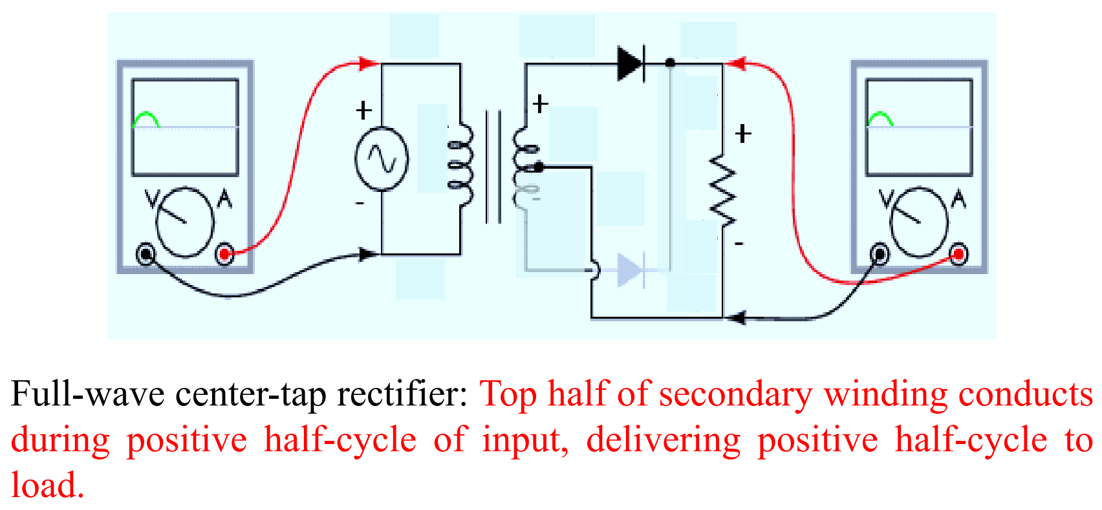
FULL wave Rectifier (Centre - tap) - working

Slide 14
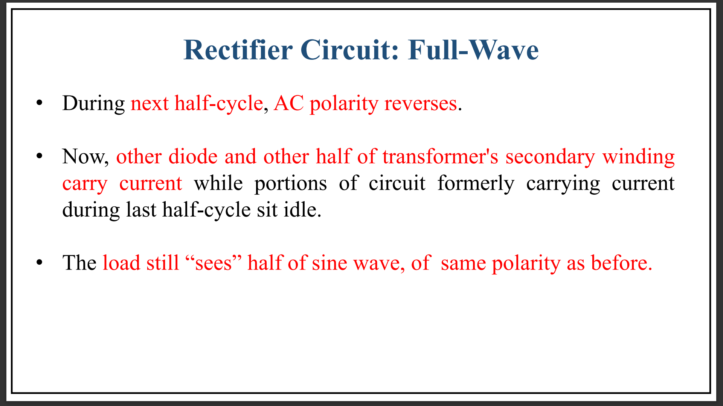
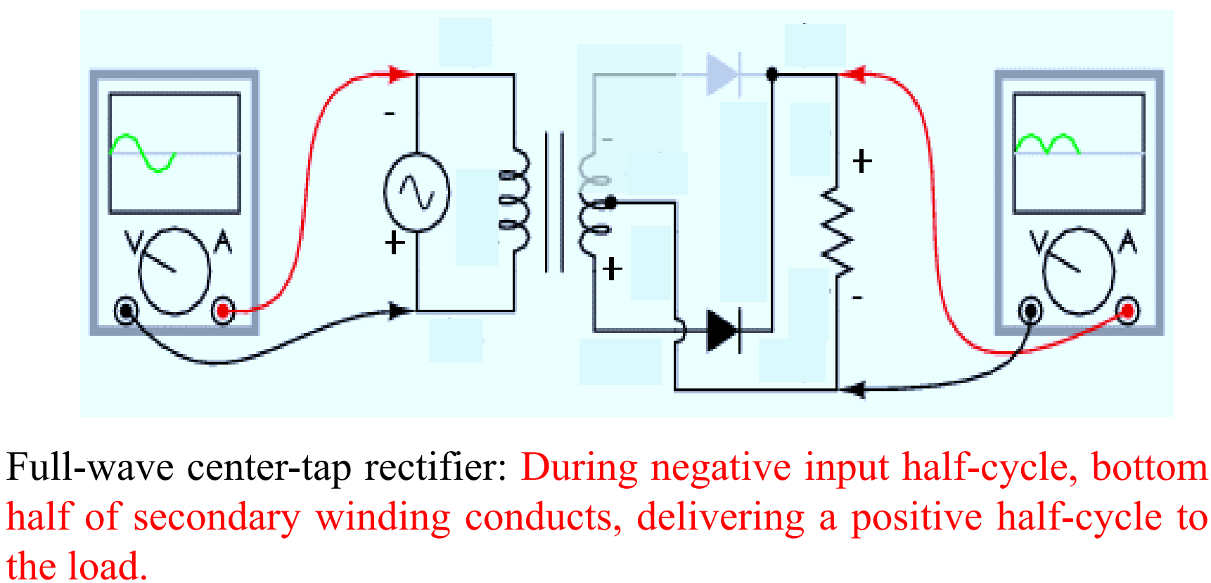
FULL wave Rectifier (Centre - tap) - working

Slide 15
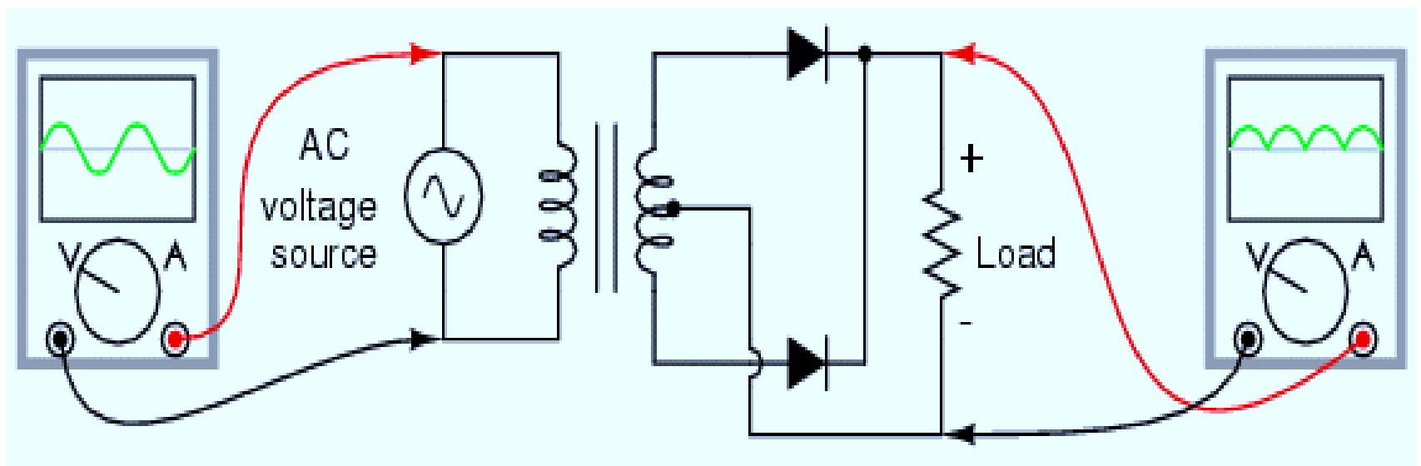
FULL wave Rectifier (Centre - tap)

Slide 16
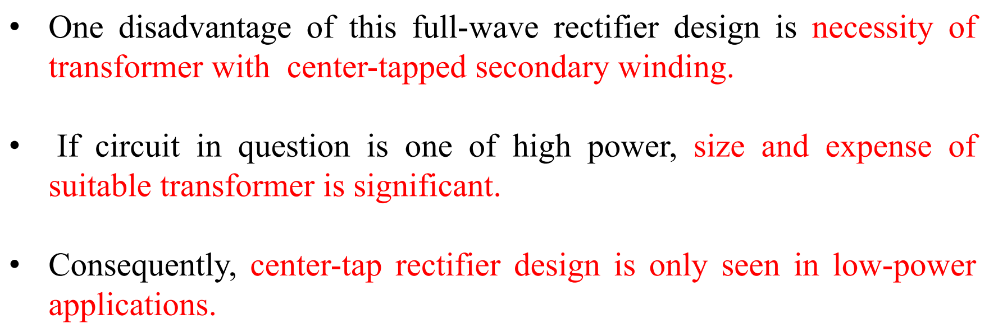
FULL wave Rectifier (Centre - tap) - Drawback

Slide 17
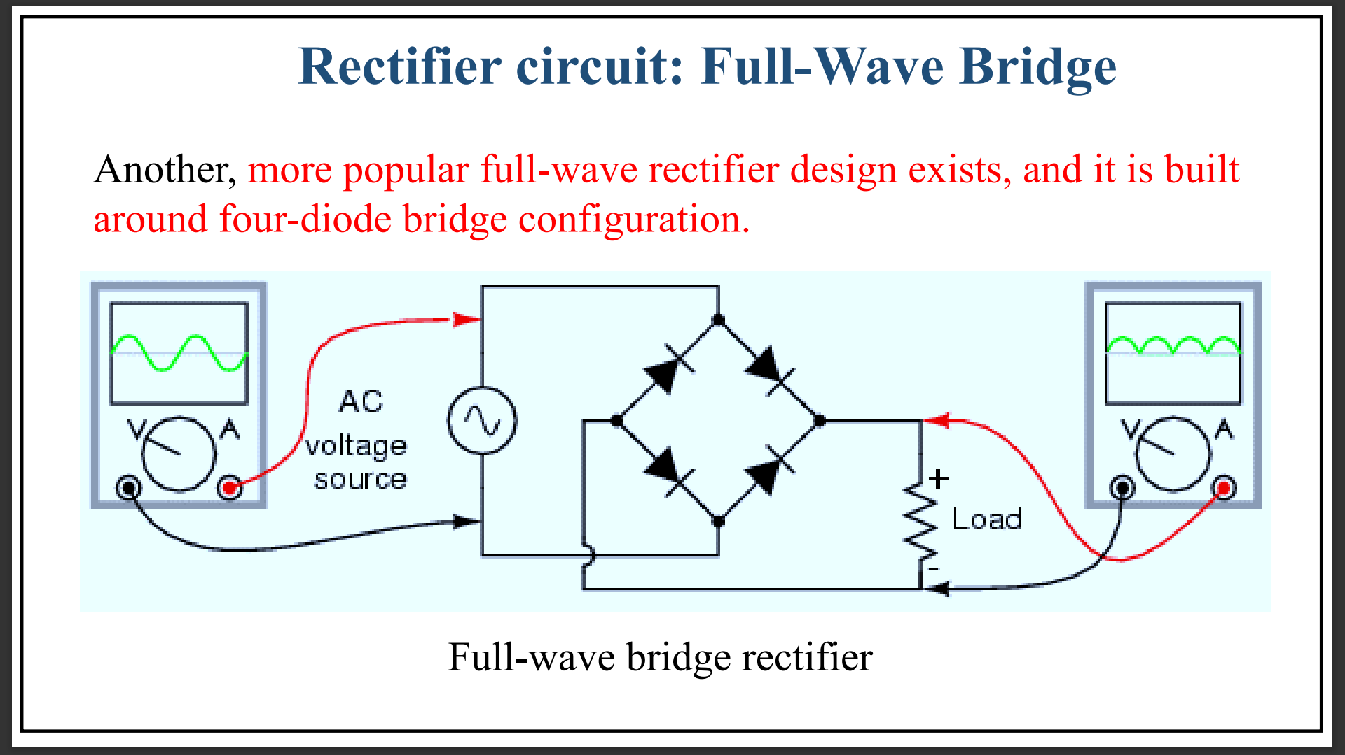
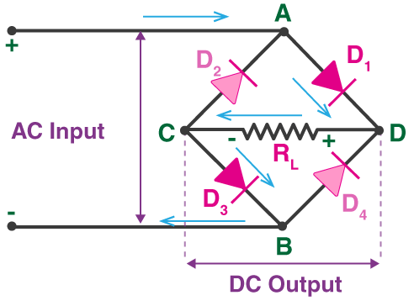
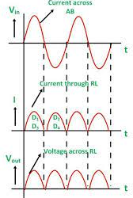
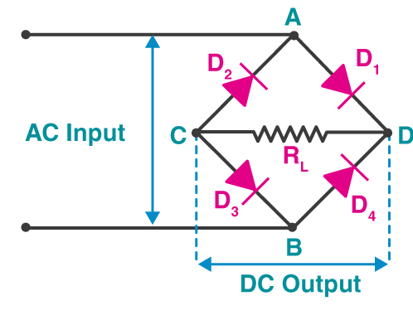
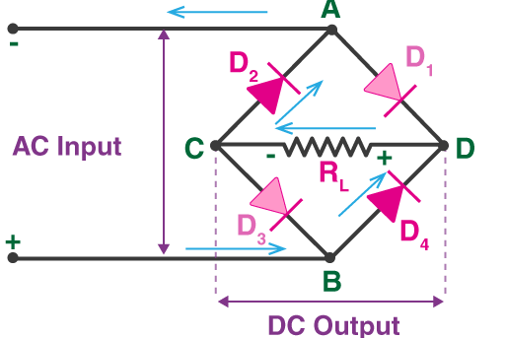
FULL wave Rectifier (Bridge)

Slide 18
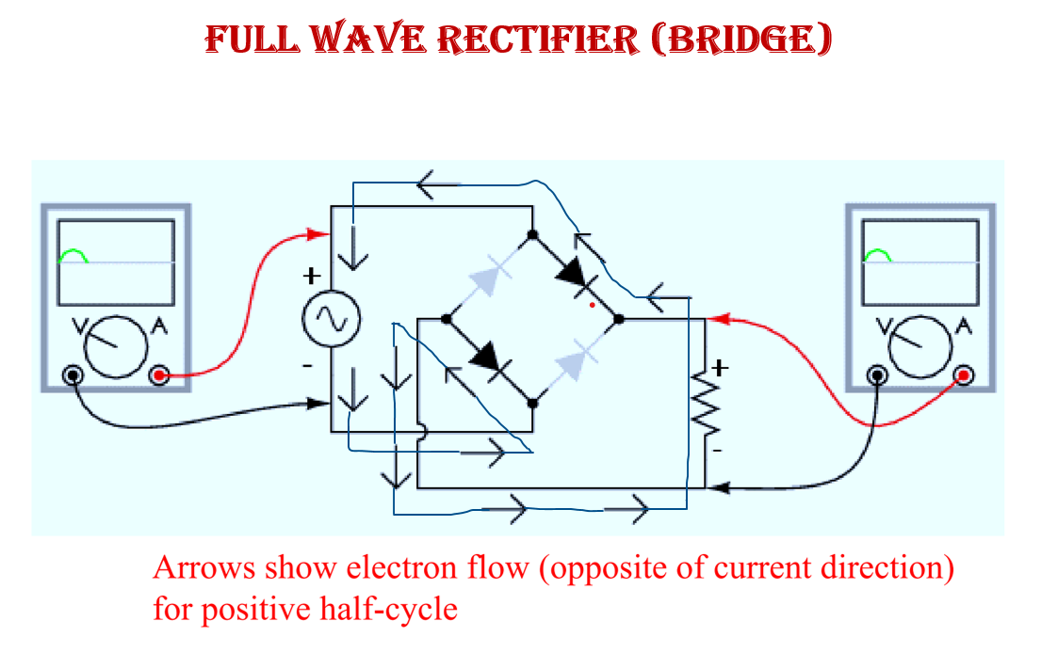
Working

Slide 19
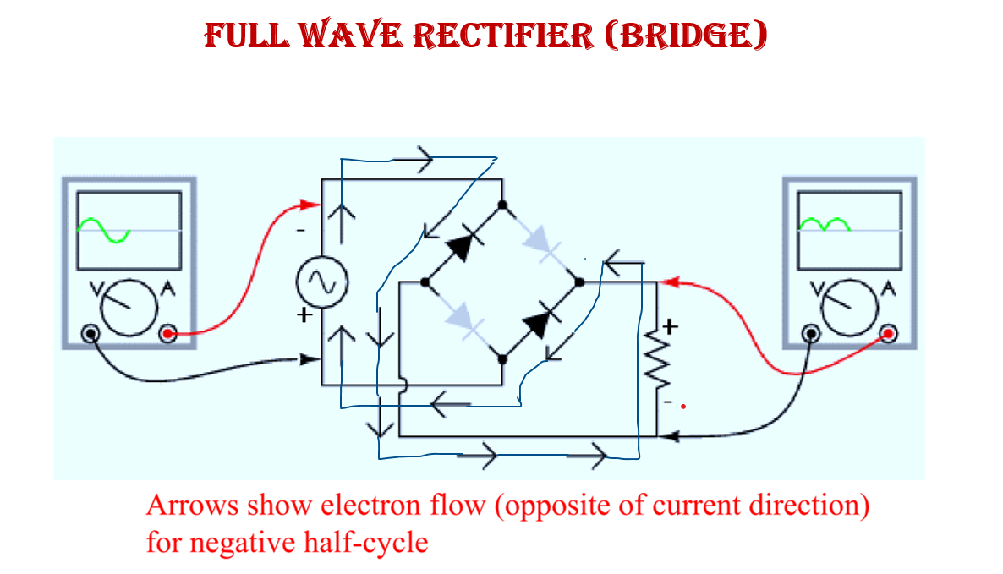
Working

Slide 20
FULL wave Rectifier (Bridge)

Slide 21
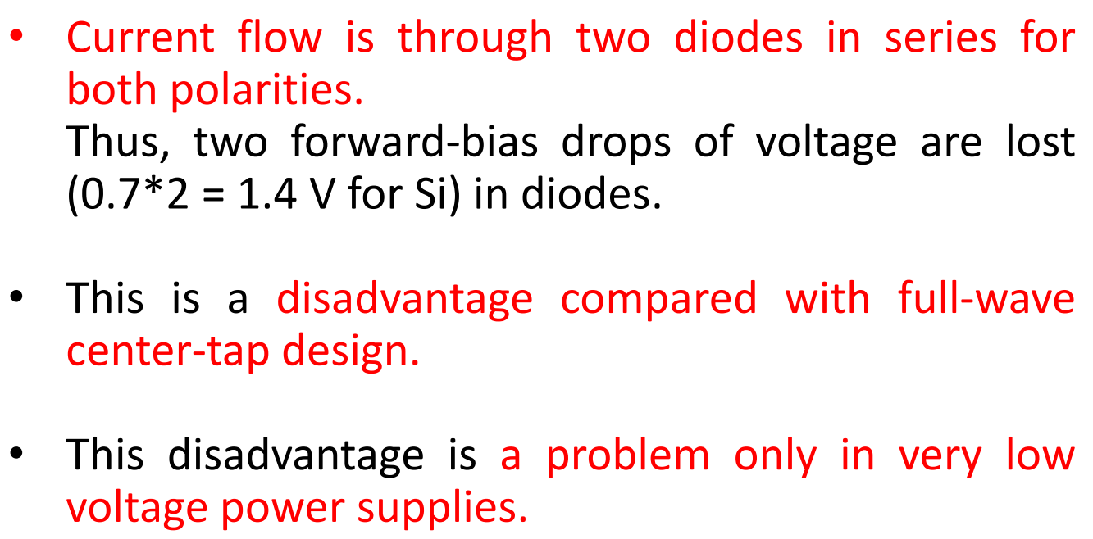
FULL wave Rectifier (Bridge) - Drawback

Slide 22
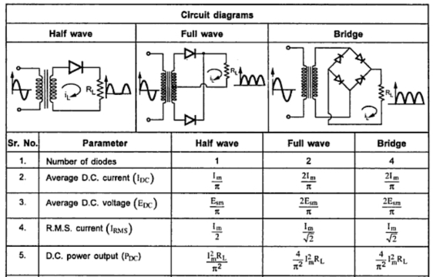
Rectifier: comparison

Slide 23
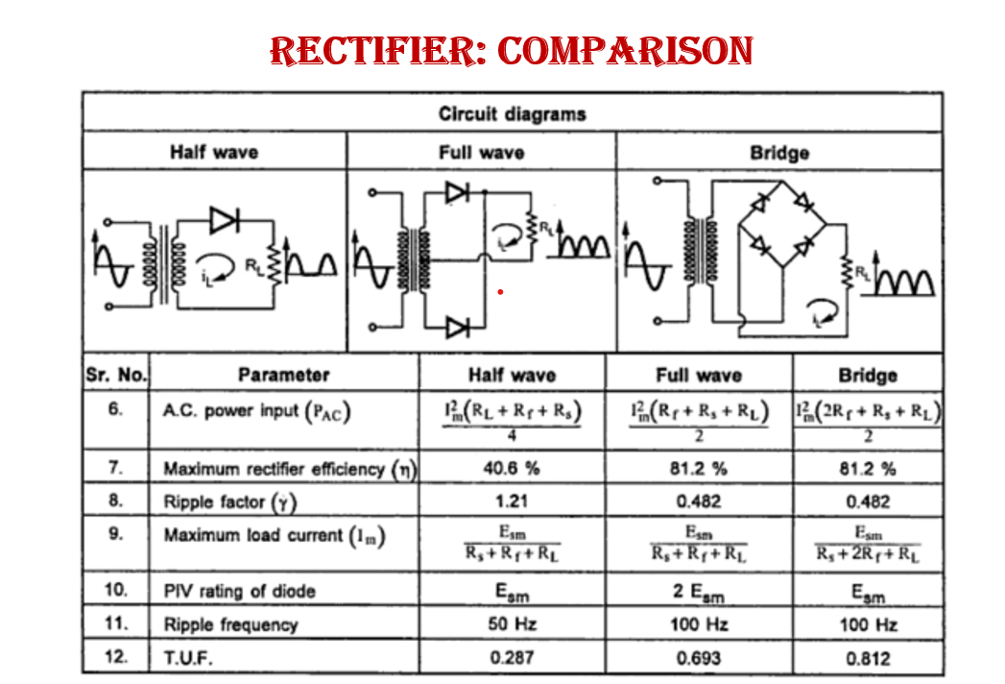

Slide 24
The maximum load current of a rectifier is the maximum average DC current it can safely deliver to a load, which is limited by the current rating of its individual diode(s)
The average DC current of a rectifier is the average value of the pulsating DC output current over one complete cycle
The RMS (Root Mean Square) current in a rectifier is the effective value of the current, defined as the square root of the mean of the squared instantaneous current values
The average DC voltage of a rectifier is the average value of the pulsating DC output voltage over one complete cycle
The AC power input of a rectifier is the alternating current (AC) electricity that is fed into the device to be converted into direct current (DC)
A rectifier's DC power output is the direct current (DC) electricity produced after converting alternating current (AC) into a steady, one-directional flow
The rectifier efficiency is defined as the ratio of the DC output power to the AC input power
The ripple factor of a rectifier is a measure of the AC component remaining in the DC output, representing how "pure" the DC is
Ripple frequency is the frequency of the residual AC voltage that remains in a DC power supply after rectification
PIV, or Peak Inverse Voltage, is the maximum reverse voltage a diode can withstand without being damaged
The transformer utilization factor (TUF) for a rectifier is the ratio of the DC power delivered to the load to the AC power rating of the transformer's secondary winding

Slide 25
Thank You !!!

